Slide 1

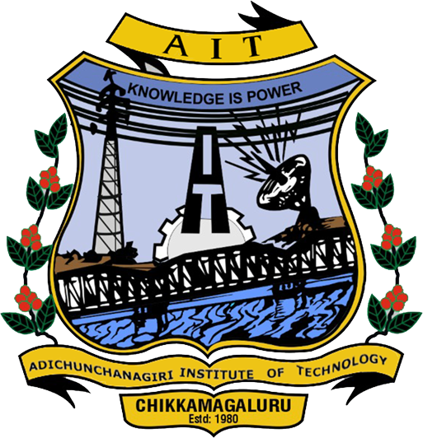
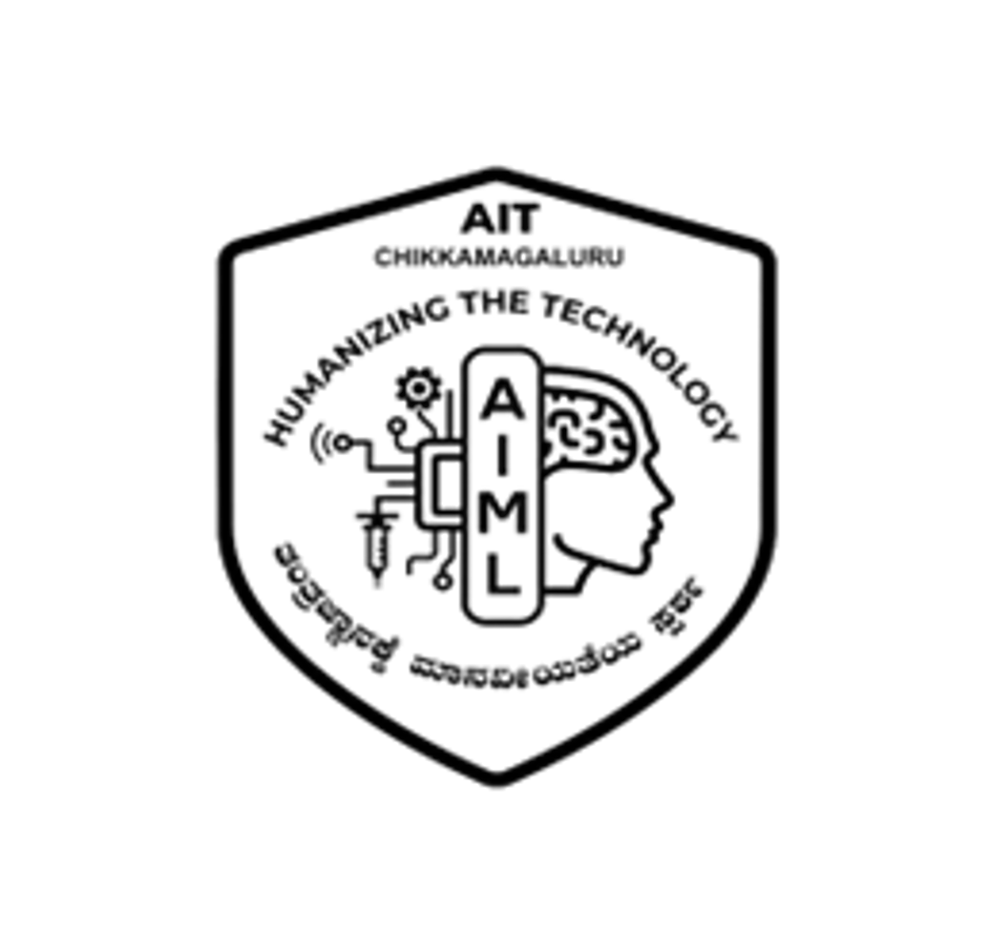
|| Jai Sri Gurudev ||
ADICHUNCHANAGIRI INSTITUTE OF TECHNOLOGY
(Affiliated to Visvesvaraya Technological University, Belagavi | Accredited by NAAC)
Chikkamagaluru – 577 102, Karnataka
DEPARTMENT OF ARTIFICIAL INTELLIGENCE AND MACHINE LEARNING
MINI PROJECT SYNOPSIS PRESENTATION [BAI586]
on
DEVELOPMENT OF AN IOT AND AI-ENABLED ROVER
FOR REAL-TIME CROP HEALTH MONITORING
Academic Year : 2026 – 2027
Under the guidance of :
  Ms. Sathyabhama R, _{B.E., M.Tech}
  Assistant Professor,
  Dept. of AI & ML,
  AIT, Chikkamagaluru.
Presented by :
  Navyashree B H (4AI24AI035),
  Shreyas R S (4AI24AI048),
  Sumaiya Firdoes (4AI24AI051),
  Tejaswini D (4AI24AI055),
  5th Semester,
  Dept. of AI & ML,
  AIT, Chikkamagaluru.

Slide 2
AGENDA
Abstract
Introduction
Literature Survey
Motivation
Problem Statement
Objectives
Scope of the Project
Methodology
Hardware & Software Requirements
System Architecture
Applications & Expected Outcomes
Future Scope
References

Slide 3
ABSTRACT
Agriculture faces challenges such as crop diseases, pests, nutrient deficiencies, improper irrigation and changing weather conditions. Farmers often depend on manual inspection, making early detection difficult and increasing the risk of crop losses, water wastage and delayed decisions.
The proposed IoT-Enabled AI-Based Smart Farming Rover uses cameras and sensors to collect crop and environmental data. AI/ML models analyze crop health, diseases, pests and nutrient deficiencies, while sensor data helps assess water stress and irrigation needs. Edge computing enables faster field-level analysis, with alerts and recommendations provided through a mobile application.

Slide 4
INTRODUCTION
Agriculture is a primary source of livelihood and food security, and its productivity depends on timely awareness of crop and field conditions.
Crops are exposed to diseases, pest infestations, nutrient deficiencies and water stress, along with erratic rainfall, drought, flooding, heat stress and fire.
Conventional monitoring relies largely on periodic manual inspection, which is labour-intensive, difficult to scale across large or remote fields and may delay the identification of emerging problems.
IoT enables continuous, low-cost sensing; mobile robots carry sensors and cameras directly into the field; and AI with computer vision helps interpret field images and sensor data.
Integrating these technologies into a single field-deployable rover provides real-time field information and decision support to farmers.

Slide 5
LITERATURE SURVEY
SL.NO | AUTHOR | TITLE | PROPOSED METHOD | DRAWBACK
1 | A. Tzounis, N. Katsoulas, T. Bartzanas and C. Kittas | Internet of Things in agriculture, recent advances and future challenges | IoT-Based Smart Agriculture: Wireless sensor networks and IoT platforms are widely used to monitor soil, climate and crop parameters with remote data access. | Most deployments use fixed sensor nodes covering limited points and provide no visual crop information.
2 | O. Elijah, T. A. Rahman, I. Orikumhi, C. Y. Leow and M. N. Hindia | An overview of Internet of Things (IoT) and data analytics in agriculture: Benefits and challenges
3 | S. P. Mohanty, D. P. Hughes and M. Salathé | Using deep learning for image-based plant disease detection | AI / Computer Vision for Crop Monitoring: Deep convolutional neural networks have shown strong results in identifying plant diseases from leaf images. | Many models are trained on controlled datasets and are seldom linked with live field sensing.
4 | K. P. Ferentinos | Deep learning models for plant disease detection and diagnosis

Slide 6
LITERATURE SURVEY
SL.NO | AUTHOR | TITLE | PROPOSED METHOD | DRAWBACK
5 | M. Ayaz, M. Ammad-Uddin, Z. Sharif, A. Mansour and E.-H. M. Aggoune | Internet-of-Things (IoT)-based smart agriculture: Toward making the fields talk | Sensor-Based Irrigation and Soil Monitoring: Soil-moisture and weather sensing are used to schedule irrigation and reduce water wastage. | Decisions often depend on a single parameter without combining weather and crop condition.
6 | K. G. Liakos, P. Busato, D. Moshou, S. Pearson and D. Bochtis | Machine learning in agriculture: A review
7 | A. Bechar and C. Vigneault | Agricultural robots for field operations: Concepts and components | Agricultural Robotics: Field robots have been developed for inspection, spraying and harvesting. | Many platforms are costly and target a single operation rather than integrated monitoring.

Slide 7
LITERATURE SURVEY
SL.NO | AUTHOR | TITLE | PROPOSED METHOD | DRAWBACK
8 | W. Shi, J. Cao, Q. Zhang, Y. Li and L. Xu | Edge computing: Vision and challenges | Edge / Embedded Intelligence: Edge computing processes data close to its source to reduce latency and bandwidth. | Low-power microcontrollers limit on-device analysis, requiring a balanced edge–server design.
9 | S. Wolfert, L. Ge, C. Verdouw and M.-J. Bogaardt | Big data in smart farming – A review | Environmental Monitoring and Data-Driven Farming: Big-data and deep-learning approaches combine weather, satellite and field data for farm decision support. | Such data are rarely combined with ground-level rover observations in low-cost systems.
10 | A. Kamilaris and F. X. Prenafeta-Boldú | Deep learning in agriculture: A survey

Slide 8
OVERVIEW OF THE PROPOSED SYSTEM
An integrated IoT + AI + Robotics monitoring system built around a mobile farming rover.
The rover carries environmental sensors (temperature, humidity, soil moisture, rain and flame), ultrasonic sensors for obstacle detection and an ESP-CAM module.
ESP32 controllers send data over Wi-Fi (WebSocket/HTTP) to a Node.js/Express backend, which stores it in MongoDB, combines it with public weather data and applies Python-based AI/computer vision analysis.
Agricultural Field
Sensors & ESP-CAM
ESP32 Controller
IoT Communication
Backend Server
Alerts & Insights
Web / Mobile Interface
MongoDB Database
AI / Data Analysis
Figure 1: Overall data flow of the proposed system

Slide 9
MOTIVATION
Crop and environmental problems often develop gradually and are easier to manage when noticed early, yet continuous manual observation of every part of a field is impractical.
Repetitive inspection is physically demanding, and some areas may be difficult or unsafe to access during fire or adverse weather.
Irrigation decisions are frequently made without reliable soil-moisture or weather information.
IoT sensing enables continuous, low-cost measurement of field parameters; AI-assisted image and data analysis can help identify possible crop and environmental risks; and a mobile rover provides remote visibility of the field.
Integrating embedded hardware with backend, analytics and user-facing software is essential to convert raw readings into timely and understandable information for farmers.

Slide 10
PROBLEM STATEMENT
Agricultural productivity is affected by crop diseases, pest infestations, nutrient deficiencies, water stress, erratic rainfall, droughts, floods, heat waves and other environmental risks.
Conventional monitoring depends largely on periodic manual inspection, which may delay the identification of emerging problems and is difficult to scale across large or remote fields.
There is therefore a need for a field-deployable intelligent monitoring system capable of continuously collecting and analysing crop and environmental information.
This project develops an IoT-enabled, AI-based agricultural rover that integrates embedded sensors, camera-based monitoring, robotics, wireless communication, AI/computer vision and software analytics to provide real-time field information and actionable decision support.

Slide 11
INPUT – PROCESS – OUTPUT
INPUT
Environmental sensor readings
ESP-CAM field images
External weather / environmental data
PROCESS
Embedded data acquisition
Wireless transmission
Backend processing and storage
AI / computer-vision-assisted analysis
OUTPUT
Real-time field status
Alerts
Decision-support information on web and mobile interfaces

